Slide 1
Adaptive Graph-Based Algorithms for Conditional Anomaly Detection
Michal Valko
Advisor: Milos Hauskrecht
Committee: Liz Marai, Diane Litman, John Lafferty (CMU)
University of Pittsburgh, December 20th, 2010.
Notes:
Welcome to my dissertation proposal. My thesis topic evolves around graph based learning.
And the main application is the conditional anomaly detection in medicine.

Slide 2
Anomaly (Outlier) Detection
Goal: Identify unusual patterns in data.
Methods: from statistics and machine learning
Contribution: graph-based methods for conditional anomaly detection
Application: medical error detection
Notes:
In general, anomaly detection is prevalent objective in many domains,
where goal is to identify unusual patterns in the data
using statistical methods.
In this work I present conditional anomaly detection.
And its application in the medical error detection.

Slide 3
Conditional Anomaly
Patient electronic records have: demographics, conditions, labs, medications administered, procedures performed,…
Notes:
Patient records today carry lot information about the patient.
And let me now draw your attention to the figure that shows where the drug for some patients should be ordered.
Every point either
+ means that the drug was ordered. – that it was not.
That’s what we call conditional anomaly.

Slide 4
Conditional Anomaly
Conditional Anomalies
Unconditional Anomalies
Assumption: Conditional anomalies correspond to medical errors
“Medical errors account for 200 000 preventable deaths a year. “
(HealthGrades study, Wall Street Journal, July 27th 2004)
Notes:
Our assumption is that many these anomalies correspond to errors, the deciosn
That physicians do about about the patient.
And it maybe very costly to do a error so it is very desirable to discover it and prevent it.
To goal is to reduce number of errors, which can improve medical care, save lifes and money.
Our contribution is in discovery of such anomalies.

Slide 5
Talk outline
Background on AD/CAD
Challenges for CAD
Approaches for CAD
Proposed Graph-Based algorithms
Semi-Supervised Learning
Online Learning
Notes:
In next slides I will talk about some background of A and CAD.
Described the challegnes that algorithm for CAD are facing
Talk about some general approach
Proposed couple algorithms.
Show the connection for SSL.
And then talk about the online setting of the problem.

Slide 6
Traditional Anomaly Detection
Nearest Neighbor
Distance – anomalies are distant (NN)
Density – anomalies in low density regions (LOF, COF, LOCI)
Classification
Model based (separate models for (ab)normal distributions)
1-class (1-class SVM)
Classify normal vs. abnormal (when labels available)
Statistical
> 3std
Notes:
Let us remind us the traditional AD. Methods in AD are very diverse and sometimes designed for a specific domain.
They that to rephrase the definition of anomaly to something that can be algorithmically searched for.
So for example NN method, look for that are either far from the others
Distance base method are using that fact that if I am further from my neighbors than they are from each other, I am probably anomaly
Density is about the thing that anomalies lie in low dens regions of the data.
For example, traditional statistical methods say that anything further that 3 standard deviation from the mean is an anomaly

Slide 7
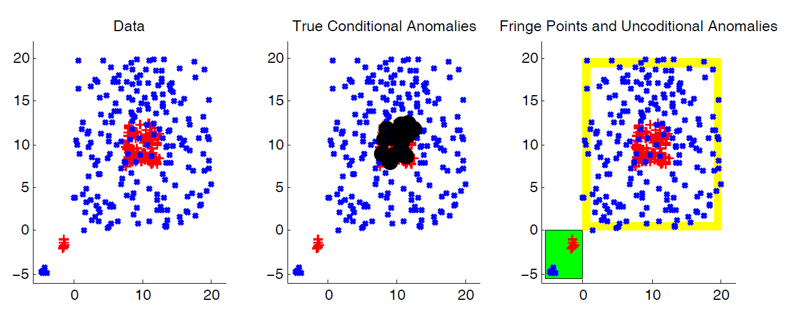
Challenges for CAD
Task: detect anomalies in labels
labels:
BLUE
RED
Dataset adopted from [Papadimitriou and Faloutsos, 2003]
Notes:
Again the topic of this work is Conditional Anomalies.
Since we are going to focus on anomalies in label, let me show an example of those.
In the left picture we have data that are mixture of two uniform square-shaped distributions: red and blue.
To the original data, we added two small outlier cluster to the bottom left corner to demonstrate the issues CAD is facing.
First what are the conditional anomalies. What do we want CAD to find? The blue crosses among red pluses/
In the middle image there are identified by huge black circles.
But what we don’t want to be bothered with.?
First, the unconditional outliers. For those we really don’t know what the label should be.
In a hospital setting, imagine patient with a unprecedented symptoms. What ever treatment he will received, we don’t want to alert on it.
The second issue that the methods face is the issue of Fringe Points.
Fringe points are data lies at the boundary of the distribution support.
Both of those thing are the challenges for CAD

Slide 8
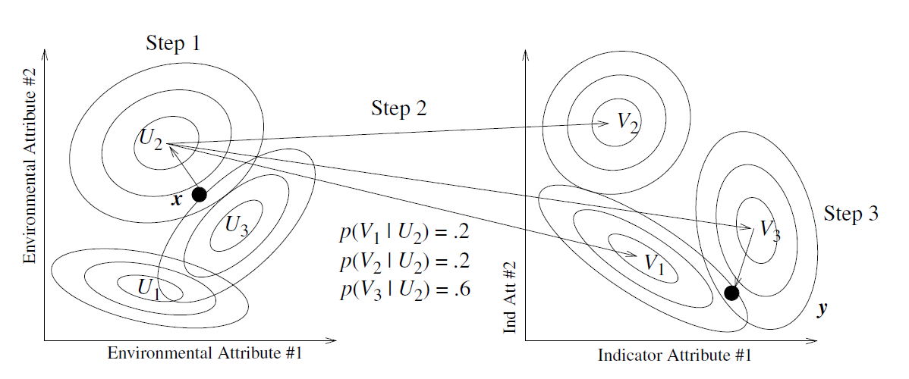
Related Work (CAD)
Conditional Anomaly Detection - Song (2007)
Uses EM to fit mixture of multivariate Gaussians and the mapping function p
Cannot influence
Can influence
Task: detect anomalies in indicator attributes wrt. environmental attributes
Notes:
For the sake of time. I will not talk about specific traditional anomaly detection methods.
They are described in the proposal document.
I describe couple very related methods: First one, is called CAD and divides all data attributes into 2 group E na Indicators.
Both of the groups are model with the mixtures of the multivariate Gaussians and the model includes the probabilitic
mapping function between those.
The biggest problem besides many parameters to learn and the locality of the EM
are the distributional assumptions, where some of the data we are dealing with are not even continuos.

Slide 9
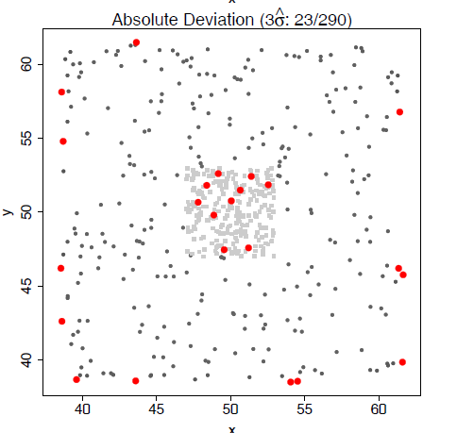
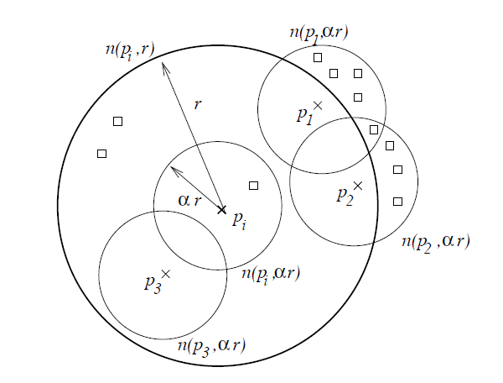
Related Work (CAD)
Cross Outlier Detection (Papadimitriou, 2003)
Fringe points
Notes:
The other related work is cross outlier detection, which compares the neighborhood counts.
The point is a cross-outlier if his neighborhood is different from his same-class neighbor neighborhoods.
A statistic from these quantities is defined and points with beyond 3std are declared anomalous.
As the authors claim, the disadvantage of this method is the fringe points, because they have different
neighborhoods than the points within the support.

Slide 10
CAD approaches
Class Outlier Approach
Discriminative Approach
Regularized Discriminative Approach
OneClass SVM, LOF, …
Connectivity AD, Soft Harmonic AD
SVM-CAD
regularizing unconditional outliers
Notes:
There are several ways how to approach the CAD problem for the anomalies in the class labels.
Remember for in this setting we consider we have all data full labeled and that goes for both the train data and the test data.
And the question we are asking is, is the label for the test cases anomalous? Or how much anomalous it is.
We will describe the three approaches to CAD and argue that the Regularized approach is the most appropriate.

Slide 11
Challenges for CAD
both train and test data are labeled
Notes:
And I repeat again that the main issues we are facing here
Are the fringe points and unconditional anomalies.

Slide 12
Class Outlier Approach
Take a test case (x,y)
Take any unconditional anomaly method
Find out if x anomalous wrt { x | x has class y }
Problems:
Fringe points
Unconditional outliers
Anomaly (alert) scores for class 1 and class 2 may not be comparable
ignores the other class(es)
Notes:
The first one is Class-Outlier approach.
This one is very easy to implement.
We take and off-the-shelf traditional outlier method and the case we want to check for being anomalous.
Look at the label. And using that method, we find out if that point is anomalous with the respect to the points with the same label.
Now, is this addressing out challenges.
Fringe points will be a big issue for a such a method, esp when the sample size is small.
Unconditional outliers would be the other: While this approach can detect if the point is far from points of its own class, it does not now if it is placed among the points from a different class, or it is just completely isolated.
The main reason why these method may not work the best, is that they ignore the other classes, which is important.
One other problem could be that the anomaly scores we get for the data points with the same label may not be comparable.

Slide 13
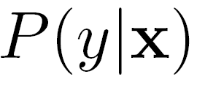
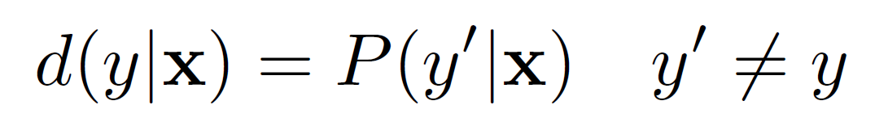
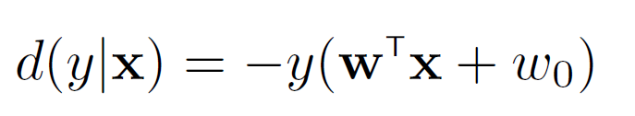
Discriminative Approach
is small → conditional anomaly
Learn Model/Build Projections
Bayes Network
bigger the alert score→ more anomalous
Support Vector Machines projections
1
2
19
3
18
4
5…16
17
boundary
margin
Notes:
So we know, we want to be aware of other classes.
In we have a probabilistic model for our data. Then we can say if the conditional probability of the label is small, then we have a conditional anomaly.
And the do not necessarily need a probability model, we can just use a projection.
First we can use a Bayesian Network that represent stochastic relations between the description and decision variables.
(One option is to use fixed structure, such as Naïve Bayes displayed on the slide, for which we can learn parameters from the data. )
Anomaly projection in this case is then posterior probability of the physician decision
Another way how we calculated the anomaly projection d was using SVM projections.

Slide 14



Support Vector Machines projections
More Anomalous Less Anomalous
5 ……….. 1 0 -1 ……… -5
Notes:
We know the true label and we know what the SVM predicted.
You can think of Anomaly here also as mislabeling.
To quantify it, we measure how far on the other side was the SVM projection from the learned hyperplane.
To have a single measure for the both classes, we simply flip one.
So the smaller anomaly projection d correspond to more anomalous cases.

Slide 15
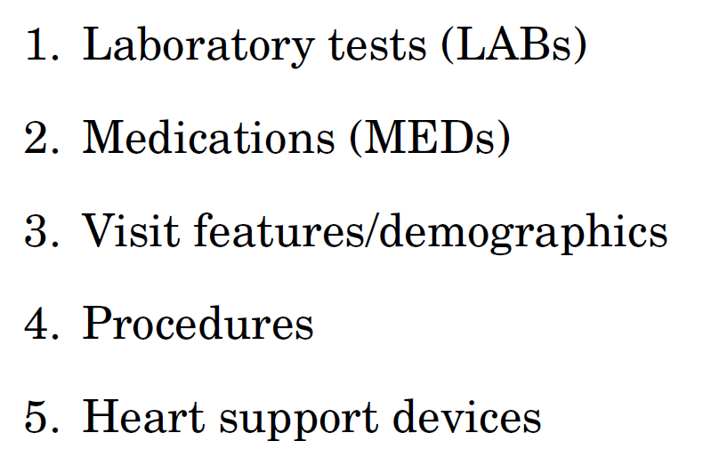
Pilot (2009) on Medical PCP Data
4486 patients from UPMC
Cardiac surgery (2002-2007)
45767 patient-day events/states
9K attributes
222 states evaluated by 15 experts
Notes:
After a one smaller study on pneumonia dataset, which is described in the document, And experiments on the artificial datasets
We evaluated just mention SVM anomaly detection we did a pilot study on the cardiac surgery patients.
The main purpose of this study was to test if we can indeed detect clinically useful alerts.
We had 4 thousand cases, which stay about 10 days in a hospital on average.
Which comes to about 40 thousand patient days.
9 thousand featers.
Of these we selected 222 cases to be evaluated by the panel of 15 experts, where each case was reviewed by 3 experts.
EMR consisted of the following 5 different sources shown on the slide.
I am not going go into details of each of those, but I will show how did we get feature from DB.

Slide 16
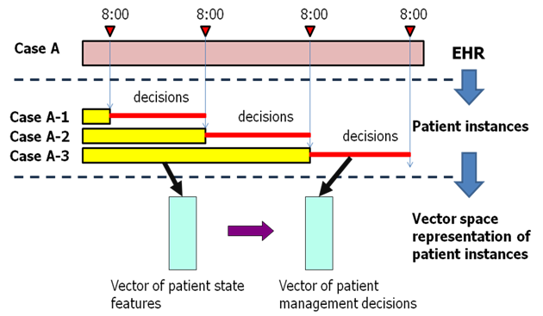
PCP data set: Segmentation
Notes:
This picture shows one patient during their stay for about 4 days.
Each day at 8am, we captured their state.
For each state we summarized it’s history until that time points in about 9K features.
And recorded what decision occurred in next 24 hours.
Decision were of the 2 kinds:
order a lab or not.
order a medication or not
And we were interested if we can detect anomalies in those decisions.

Slide 17
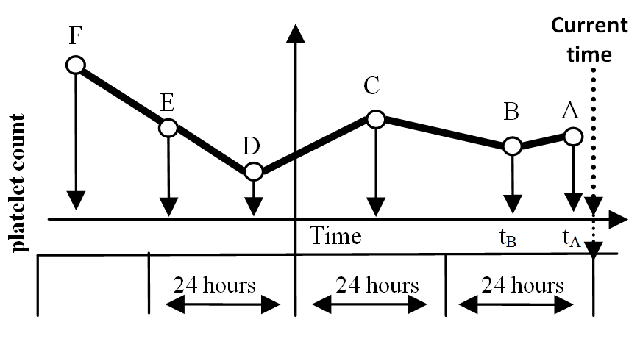
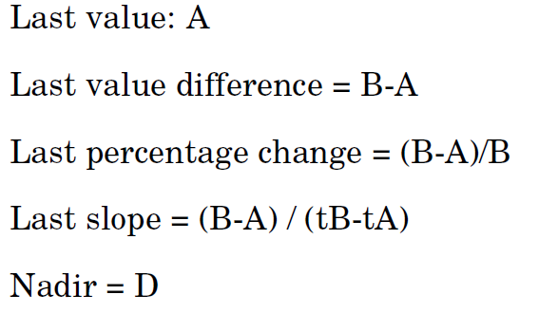
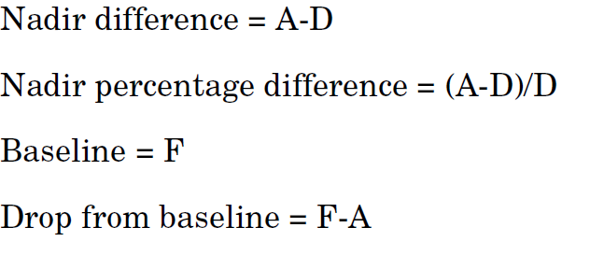
PCP Dataset: PLT Lab feature
Notes:
In this picture I am showing the how we constructed the feature. Say there were 6 labs of platelet count performed.
And example of the features we constructed from it.

Slide 18
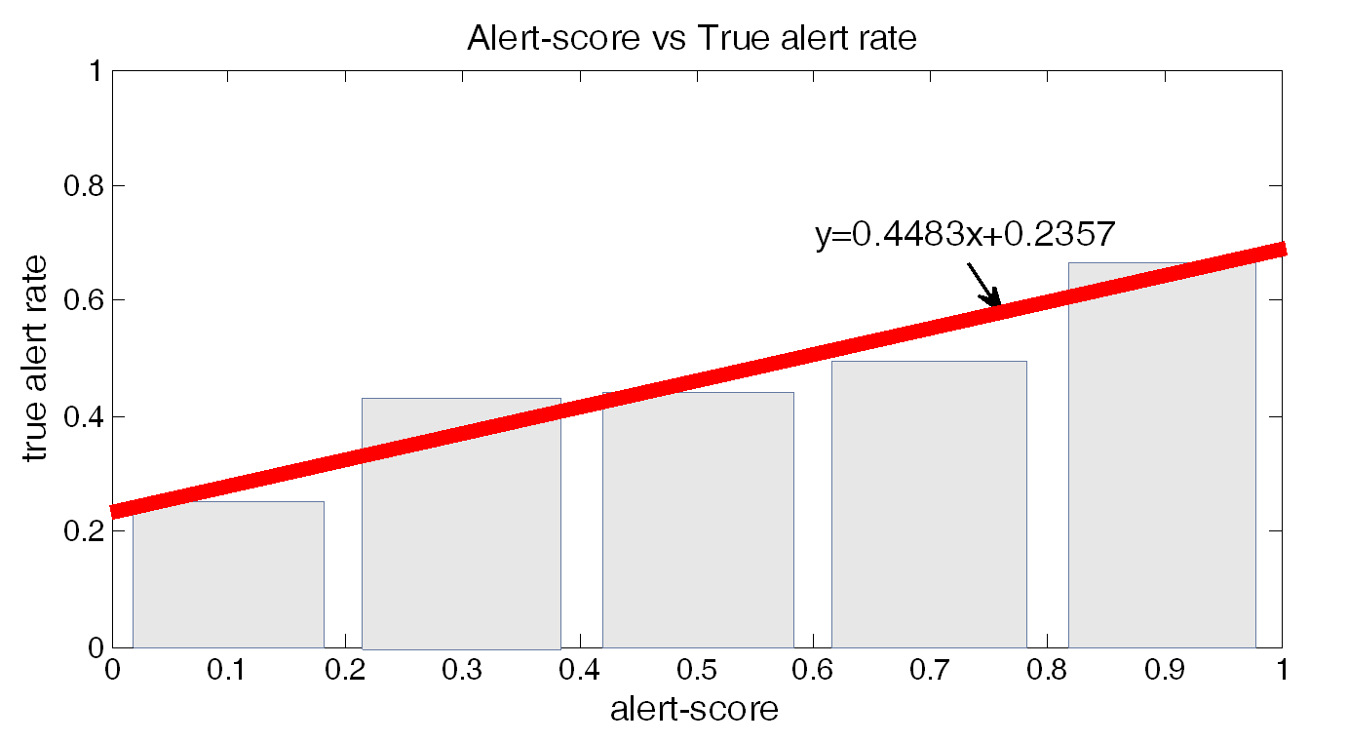
PCP Dataset
AUC: 64.12%
conclusions
Alert score correlates with true alert rate
Clinical useful anomalies can be learned

Slide 19
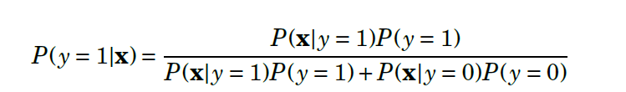
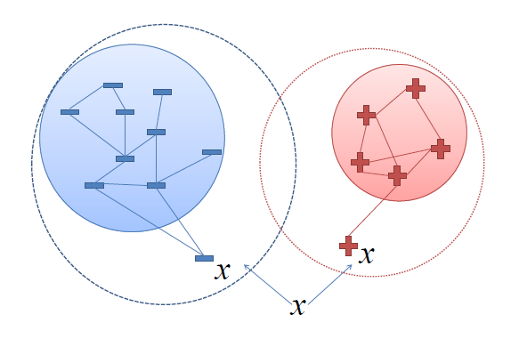


Connectivity AD
Bayes theorem
Probability of being in x during the random walk
x₄
x₅
x₁
x₇
x₆
x₃
x₈
x₉
x₂
new generative nonparametric model
Notes:
The previous method was and example of the discriminative approach.
Let’s consider the probabilities again. In general we can apply the Bayes theorem as shown.
One option how to estimate the likelihood is with random walk on a data similarity graph.
Data similarity graphs shows how close are the examples to each other based on their attributed.
Let us also image the random walk on this graph, starting from any node and jumping randomly according to the similarities.
Once we constructed such a graph, let us use it to Let us approximate the likelihoods.
First we treat positive and negative labels and construct similarity graphs for both of them from the training set.
Then we take the case in hand x and add it to the both graphs.
And we estimate that the likelihood of x given it’s label is the probabilty that the random walk on this graph
Since this method builds on the graph connectivity, we will call it connectivity AD.

Slide 20
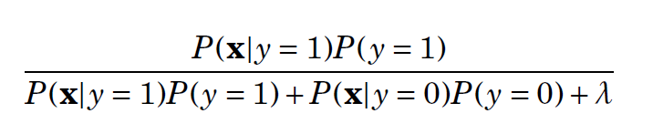

Regularization of Connectivity AD
What happens if we encounter an unconditional outlier?
outlier
a general way to regularize a discriminative approach
both small
but one is magnitudes larger
Notes:
Well this was just another example of the discriminative approach.
We will use to demonstrate one of challenges that I mentioned earlier.
What happens if have an unconditional outlier, a point far away from the rest of the data.
Since it has no close neighbors we should not be confident about its labels.
The random walk probabilities will be both small.
The problem is that one of them can be magnitudes larger than the other.
And because of that we will falsely be confident WHAT one of the labels IS.
This is a problem. How can we fix it?
We can add a small regularization constant.
The probabilities of the case being positive and negative will not add up to one.
And in this displayed case they would be small for both.
You can think of it as having an additional class with the meaning EVERYTHING ELSE.

Slide 21
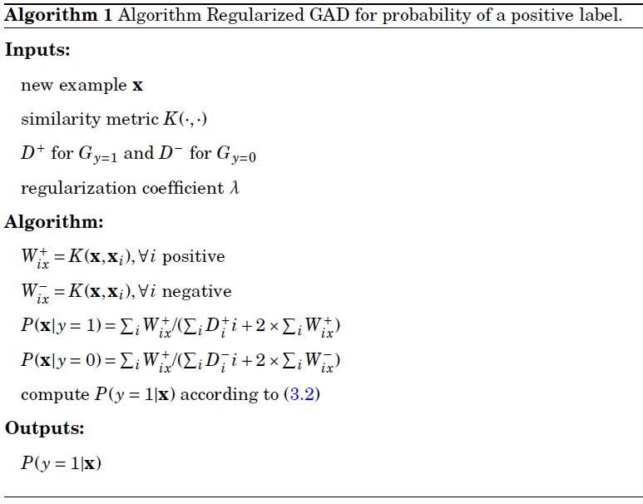
Algorithm
ConnectivityAD
Notes:
One advantage over the other graph based algorithms, it’s there it’s efficiency.
It does not need to store all NXN similarity matrix for the training data
And only requires NN kind of computation and no matrix inversion.
Let’s look how it handles the challenges.

Slide 22
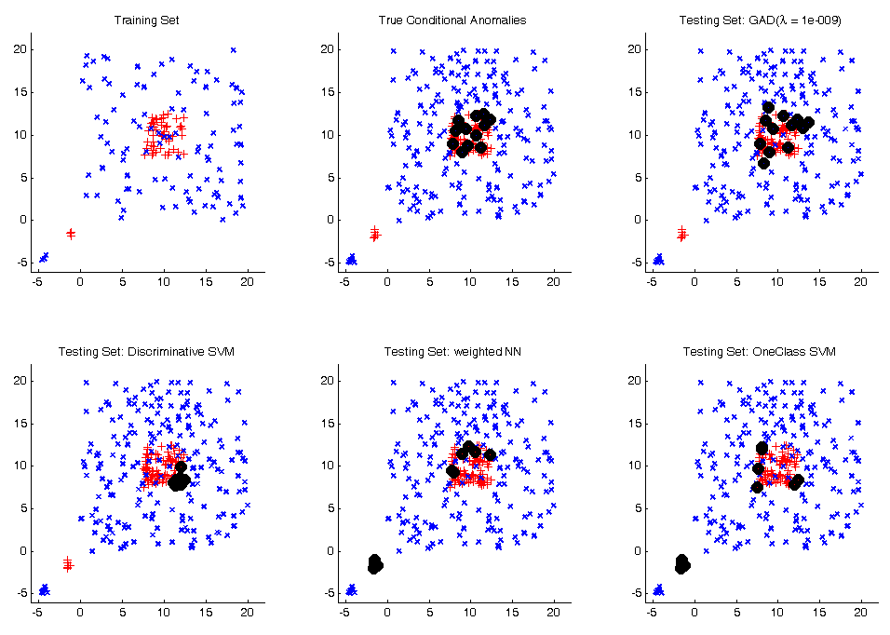
Synthetic Core Dataset
TOP 10 Scoring anomalies for each method
Connectivity AD
Fringe points
Fringe points
Outliers
Outliers
Notes:
In this experiment we took a dataset from spiros and papadimitrout.
And tested 4 methods. Just proposed regularized connectivitYAD
Previously proposed SVM-based.
Weighted NN, which is closely related to connectivityAD.
And a popular One Class SVM method, as an example of a class outlier method.
We are showing TOP 10 scoring anomalies for each of them.
In a summary only the regularized discriminative method was able to deal with both fringe points and unconditional outliers.

Slide 23
ConnectivityAD summary
Pros
Can handle
Fringe points
Unconditional Anomalies
Fast
O(n) memory,
O(|E|) time
Cons
Connectivity vs. Density
Calibration
Notes:
In a summary connectivity AD can handle the bad cases
It is fast and does not require lot of storage.
The disadvantages are that we still need to understand the relationship between connectivity and density estimation.
And from that follows that the probability score are not well calibrated.

Slide 24
Talk outline
Background on AD/CAD
Challenges for CAD
Approaches for CAD
Discriminative Approach: SVM-AD
Regularized Discriminative Approach: ConnectivityAD
Unlabeled Data & Semi-Supervised Learning
Soft Harmonic AD
Online Setting
Future Work
Notes:
In next slides I will talk about some background of A and CAD.
Described the challegnes that algorithm for CAD are facing
Talk about some general approach
Proposed couple algorithms.
Show the connection for SSL.
And then talk about the online setting of the problem.

Slide 25
SSL in medical data
“negative” patient:
_
1
_
1
_
1
_
1
_
1
time_{t-2} time_{t-1} time_{t} time_{t+1} time_{t+2}
“positive” patient:
?
?
1
?
?
time_{t-2} time_{t-1} time_{t} time_{t+1} time_{t+2}
lab test order
missing data
unknown labels in nearby times
Notes:
We are going to address this with another graph-based approach,
Which is related to semi-supervised learning.
So far we have not talked about unlabeled data in our medical application.
However, we encounter them in 2 ways
Is the missing data. Our data come from archiving system call MARS which is a merger of several other EMR system. For various reason some date are missing.
The other we encounter unlabeled data is as follow: Say we have a patient at 5 times points. And a rare test that is ordered to confirm a specific disease.
If it was ordered at time T we can say that this instance is positive.
But can we can say instance at T-1 or T+1 was negative, because it was not ordered then?
Not really. Especially when we can believe that the condition at the time T and T+1 don’t change much.
Such data we can treat as unlabeled.
On the other hand if the test was not ordered during all patient stay, we can probably say that all those are the negative cases.

Slide 26




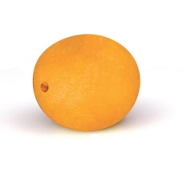
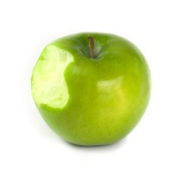
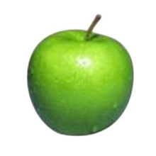
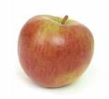
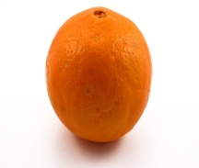

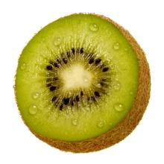


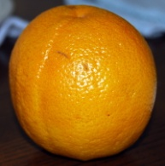
Harmonic Solution for SSL
0.4
-0.9
0.6
-0.5
0.7
0.0
0.6
0.7
0.4
0.2
-0.4
0.1
apple
-1
0.9
1
-0.7
0.7
orange
0.9
0.6
0.0
0.9
-0.9
-0.2
0.9
0.7
0.1
0.9
0.8
-0.8
Notes:
Let us review the graph based SSL technique we will built on.
We again construct a data similairirty graph.
In this example we will have only 2 labeled nodes, 1. -1.
Let us described how would we infer the labels for the remaining nodes.
One way we can imagine the inference is again of a random walk. DESCRIBE
Another way we can think of it is spreading the labels.

Slide 27
Dealing with Outliers
SINK
0
0.4
-0.9
0.6
-0.5
0.7
0.0
0.6
0.7
0.4
0.2
-0.4
0.1
apple
-1
0.9
-0.7
1
0.7
orange
0.9
0.6
0.0
0.9
-0.9
-0.2
0.9
0.7
0.1
0.9
0.8
-0.8
kiwi – outlier
Notes:
That was nice… but sometimes we may get a fruit that it’s not orange or apple we want to classify.
By this approach we would assign to some of the labeled ones, which would be wrong.
To tackle this issue we introduce a SINK a face that does not belong to anybody with the same weight gg.
Gg as before act as regularized. As we do the random walk that I described earlier at every step we can finish in the sink and stop.
What will happen with those we inferred?

Slide 28
Dealing with Outliers
SINK
0
0.4
-0.7
0.5
-0.2
0.7
0.0
0.4
0.7
0.4
0.2
-0.2
0.1
apple
-1
0.9
-0.4
1
0.7
orange
0.9
0.6
0.0
0.9
-0.7
0
0.7
0.7
0.1
0.9
0.6
-0.6
kiwi – outlier
Notes:
What will happen with those number we inferred?
As gg increase, the label will go closer to 0.
And for the nodes that are far away from others, it will go to 0 faster.

Slide 29
Regularization
labeled data
Low
confidence
ONLY LABELED ALL DATA
Notes:
There is a parameter that we introduced by this SINK, and that is how big of a weight we put on those
Just labeled data … all data na x os
Interpolaciu medzi unlabeled and just labeled …. All data (naprava) …
Treba popisat obrazky

Slide 30
Harmonic Solution
A standard approach:
Rewritten in terms of the graph Laplacian L = D – W:
Properties of the solution:
Smoothness
Computable in a closed form
Interpretable as a random walk on the graph W with the transition matrix
Graph weights
Notes:
In this slide we display formally what was shown on the previous slides

Slide 31
Regularized HS
To control the confidence of labeling unlabeled examples, we compute the regularized HS:
Properties of the solution:
Computable in a closed form
Interpretable as a random walk on the graph W with an extra sink. At every step, the walk may terminate at the sink with probability
A neat way of filtering outliers and fringe points

Slide 32
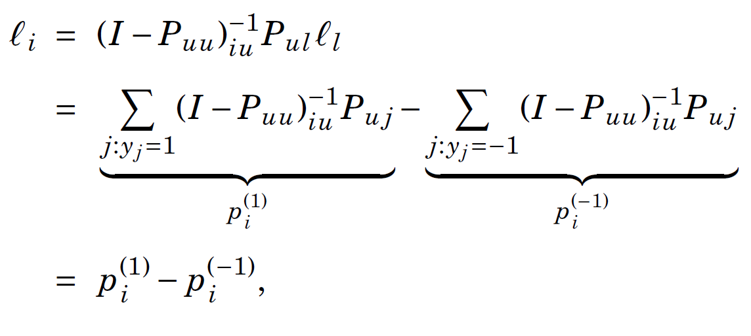

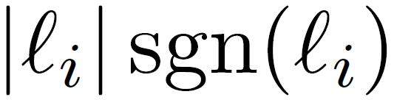



Regularized HS for CAD
-0.2
=
0.2
x
-1
when is rewritten as
can be interpreted as a confidence
>> 0.5 and
Conditional Anomaly!
Notes:
The reason why I shown this formal definitions is that we can rewrite inferred labeled as
A differencen between probability of a positive and negative label.
The other observation we are going to make is that inferred label ranging from -1 to 1 can,
Rewritten as the absolute value times sign.
While sign can be interpreted as the inferred label.
Absolute value can be interpreted as a confidence
The reason we rewrote this that way is that when the confidence of the inferred label is high and
The inferred label is different that the actual label, we have an conditional anomaly!
And the confidence can directly serve as an anomaly score.

Slide 33




Soft Harmonic Solution
Unconstrained Regularization
fit to data
regularizer
Close form solution
Why Soft Harmonic Solution for Conditional AD?
Notes:
In general, the just described algorithm falls under the bigger class of unconstrained regularization algorithms
Which consist of fitting that data a regularization which usually penelizes for not following the structure.
In graph-based algorithm, this regularized is often related to graph laplacian, regularized graph laplacian in our case.
And it it penalized for non smooth assigmnent of the labels.
C is usually a diagonal matrix, and it describe how much we want the inferred labels fit the training labels.
In the just described algorithm this value was infinity.
Which could be a problem for our problem, when we had lot of labeled data.
In case NN graph, the method would mostly be just a NN.
For that case we will enforce the fitting constrains in the soft manner.
Also our theorical result assume the soft constrains.

Slide 34
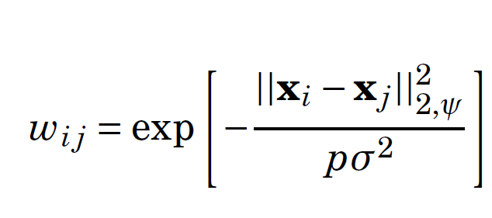
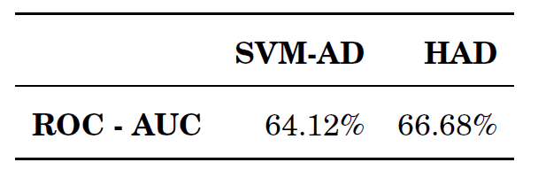
Medical Dataset
Biased selection of cases
Distance metric:
3-NN graph
Labels: lab test or medication orders
Measure: ROC of a case being conditionally anomalous

Slide 35
Online Setting
Data arrive in the streams
Need to adapt (D_{Train} ≠ D_{Test})
Eg. Medical practices change
Online Learning naturally fits the problem
Notes:
I will now describe the online setting of the problem.
Data we are dealing with arrive in the stream.
For example patients constantly come to the hospital and the medical decision are made for them.
The training set may not resemble the testing set, for example medical practices change.
Such a setup naturally fits the online learning problem.
When the learner is required to adapt and produce an output at the same time.

Slide 36
Online HFS
Inputs: an example x_{t}, a data adjacency graph W
Algorithm:
Add x_{t} to the graph W and compute the Laplacian L
Infer labels on the graph:
Predict
Outputs: a prediction , an updated data adjacency graph W
What is wrong with this algorithm?
O(t)
O(t³)
Notes:
So how can we make our algorithm online?
Here is the trivial way.
New point come, add the to the graph
Infer the labels, predict or raise t an anomaly
It’s the time complexity
Inference of the labels involves an inverse, and a solving a SLE.

Slide 37
Online HFS
Inputs: an example x_{t}, a data adjacency graph W
Algorithm:
If the graph W has more than M vertices, quantize it
Add x_{t} to the graph W and compute the Laplacian L
Infer labels on the graph:
Predict
Outputs: a prediction , an updated data adjacency graph W
O(M)
O(M³)
Notes:
So we propose the following:
We will only keep a limited number of (sat M) representative nodes.
When we should add more that that we quantize it.
And by quantizing we decides which vertices we keep and how much weight we put on them.
Consequently the graph size will stay constant, and so will be the complexity.

Slide 38

Why Online Learning?
Data arrive in the streams
Need to adapt (D_{Train} ≠ D_{Test})
Eg. Medical practices change
Online Learning naturally fits the problem
Complexity issues
Ω(n²) in general - construction of an nxn matrix
inverse operation on an (n x n) matrix - O(n^{2.4})
What about Nyström?
Incremental k-centers
d(x, C_{x}) < R
d(C_{x}, C_{y}) > R
Notes:
So the reason for quantization is the scabality
When dealing with big matrices and their inversions many people take advantage of the Nystrom method
In which we have to sample some of the columns.
Unfortunately we are not aware of any extension for the online learning.
For that reason we use incremental k-center clustering, which does not have any distributional assumptions
And comes with guarantees, that we can use in analysis.
In particul it keeps updating some radius R and makes sure that no point is more than R away from its representative vertex and all representative vertices are at least R away.

Slide 39

Incremental k-centers
2
3
R
>R
R
R
M = 3
Notes:
Let’s just quickly describe how it works. We wan to keep only 3 nodes in the graph.
We will have some R.
If the new one come and is within the R, we just increase the conut

Slide 40
Incremental k-centers
8
R
5
R
R
6
Notes:
What if one come and it is further than R, then we double R and recluster
So the invariant holds

Slide 41
Incremental k-centers
2R
8
9
5
>2R
2R
2R
6

Slide 42
Theoretical Guarantees
We prove a regret bound of the form:
The errors are bounded on the order of
online quantized
true
offline
true
online
offline
Offline learning error
Online learning risk
Online learning error
Quantization error
online quantized
online
Notes:
Because we our data compression is just an approximation. We would like to now how accurate it is.
We actually proved bounds, that in a nutshell say that the more unlabeled examples we see, the closer we are getting to the true solution.
We have 3 kinds of errors that we bound separately.
First is the error, we incur from extrapolation, from not able to see all the data in advance and 3rd, from quantzizatio
And we proved that our rate of convergence is fast enough.

Slide 43
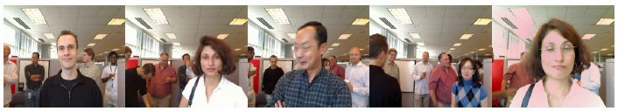
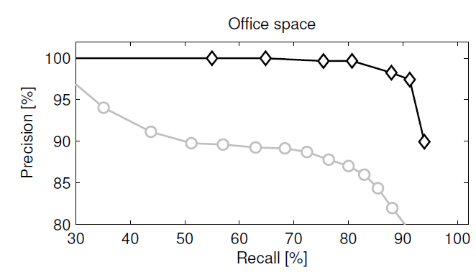

Online SSL experiments
Multi-class: 8 people who walk in front of a camera and make funny faces.
When a person shows up on the camera for the first time, we label four faces of the person.
BETTER
Our algorithm
Nearest Neighbor
Task: Classification
Notes:
We performed online SSL experiments on the real face recognition dataset
When we had 8 walking in front of the camera and make the funny faces.
The experiments that compare to the other methods which work for binary
are in the document.

Slide 44
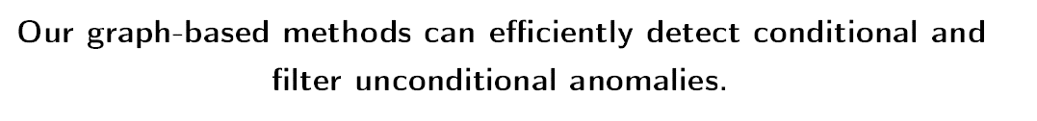
Summary
Conditional AD
Discriminative Approach
SVM-based AD
Pilot Study (2009)
Regularized Discriminative AD
Regularized ConnectivityAD
SSL: Max-Margin Graph Cuts [in the proposal document]
Online Learning with Quantization
Bounds on quality of the solution
Health Care Costs
Dr. Reinhardt NYT 12/19/2011
Thesis Statement

Slide 45
Proposed Future Work
Online Soft Harmonic Anomaly Detection
Quantization with multiple Classes
Lot of labeled data (need to quantized them as well)
Extend incremental k-center
Theory for Anomaly Detection
New human expert evaluation of alert
Thanks to: Branislav Kveton, Greg Cooper, Tomas Singliar, Shyam Visweswaram, Iyad Batal,
Hamed Valizadegan, Amy Seybert, Rich Pelikan, Saeed Amizadeh,
Shuguang Wang, Quang Nguyen, Dave Krebs
Notes:
We plan to evaluate our approach for the online Anomaly detection task.
We plan to quantization for multiple classes, we probably don’t want to quantize positives and negative
but how many representative vertices we want to reserve for positive and negative vertices.
We plan to further analyze anomaly detection.
Perform another evaluation with the human experts.
Do more adaptive incremental clustering.
And make use of parallelization

Slide 46
Proposed Future Work (con’t)
Incremental clustering with forgetting the history
To address context drift
Recent data more important
Parallelization of harmonic solution
Thanks to: Branislav Kveton, Greg Cooper, Tomas Singliar, Shyam Visweswaram, Iyad Batal,
Hamed Valizadegan, Amy Seybert, Rich Pelikan, Saeed Amizadeh,
Shuguang Wang, Quang Nguyen, Dave Krebs
Notes:
We plan to evaluate our approach for the online Anomaly detection task.
We plan to quantization for multiple classes, we probably don’t want to quantize positives and negative
but how many representative vertices we want to reserve for positive and negative vertices.
We plan to further analyze anomaly detection.
Perform another evaluation with the human experts.
Do more adaptive incremental clustering.
And make use of parallelization

